Slide 1
FCSS 101

Slide 2
Family and Community Support Services (FCSS)
What does FCSS do?

Slide 3
A Bit About FCSS
FCSS is unique in Canada
80/20 partnership between municipalities or Métis settlements, and the province
FCSS Act and Regulation
sets out the mandate and requirements of FCSS Program
describes the responsibilities and requirements of municipalities and Métis settlements, and the province, in providing FCSS locally
communities “design and deliver social programs that are preventive in nature, provided at the earliest opportunity to promote and enhance well being among individuals, families, and communities”

Slide 4
Key principle of local decision-making
Municipalities and Métis settlements decide how to allocate funding and resources to best meet needs and priorities of community
Key principle of community development
based on the belief that self help contributes to a sense of integrity, self-worth and independence
“people helping people” approach to improving quality of life and build capacity of families and communities to prevent and/or deal with crisis situations should they arise

Slide 5
Eligible and Non-Eligible Services
Services and Projects that may be offered:
assist communities to identify their social needs and develop responses to meet those needs, including:
raising public awareness around community issues
coordinating responses to identified issues
developing strategies for community advocacy
developing comprehensive social community plans and initiatives
research: surveys, forums, community assets/needs, environmental scans, service reviews, strategic planning, program planning
in-kind support to community-based groups (until they are able to sustain themselves) such as provision of office space, printing, photocopying, help with preparing proposals, etc.

Slide 6
promote, encourage and support volunteer work in the community, including:
recruitment, training and placement services
resources to support volunteers
volunteer recognition
coordination of volunteer services
inform the public of available services, including:
information and referral services
community information directories
newcomer services
interagency coordination

Slide 7
enrich and strengthen family life by developing skills so people can function more effectively within their own environment, including:
mentoring programs
parenting and family life education and development programs
programs for single adults and single parents
courses designed to enhance self-awareness and personal growth
individual, family and group counselling services that are educational and not treatment oriented
youth development and leadership services

Slide 8
enhance quality of life of the retired and semi-retired, including:
home support services
education and information services
coordination of seniors services and programs
self-help socialization activities
promote the social development of children and their families, including:
parent-child development activities
early childhood development services for children 0-6 (excluding childcare)
support services for young children aged 6-12

Slide 9
Services provided under a local FCSS program must not
provide primarily for recreational needs or leisure time pursuits
offer direct assistance, including money, food, clothing or shelter to sustain an individual or family
be primarily rehabilitative in nature
duplicate services that are the responsibility of government or government agency

Slide 10
Expenditures of a local FCSS program shall not include
the purchase of land or buildings,
the construction or renovation of a building,
the purchase of motor vehicles,
any costs to sustain an organization that do not relate to an FCSS funded service,
municipal property taxes and levies, or
any payments to board members, except out of pocket expenses incurred on FCSS business

Slide 11
Local FCSS Program Delivery
Preventive social services are provided in FCSS communities by direct service delivery, or through external grants, or a combination of both.
Direct Service Delivery
services are provided by FCSS program staff or service providers under contract
i.e. a youth worker may be an employee; a home support service may be provided through an ongoing contract; a contract may be struck with someone to provide a one-time series of 6 parenting courses
External Grants
FCSS funds granted to local organizations and groups to deliver services or projects - “FCSS funded agencies”
can be ongoing grants or one-time projects
must meet FCSS eligibility guidelines
grant applications and year end (or at the end of the project) reporting must be in place for accountability to the province

Slide 12
 | Community Development Versus | Community Based Services
 | Community Development | Community Based Services
Basis of Approach | Community Driven to i. Identify needs ii. Build Strengths | Problems driven
Problem definition | Community defines BOTH | Service Providers, government or outside institutions define problem
Vehicle For Creating Change | Building Community control and capacity | Information, education and direct services & program delivery
Primary decision makers | Informal and formal community leaders | Service Providers, government or outside institutions
Role of Professionals | Resource to Community Bring parties together Collect information Facilitate Action Can lead to program/service/advocacy Build Community Partnerships & Relationships | Decision Makers NOT Community Driven
Examples | FCSS examples: - Networking and Information sharing Research to inform key decision makers and community action. Coordination of Community Response to issues such as Housing/domestic violence/Transportation/ Poverty/ Youth Homelessness/Economic Downturn Crisis | Community Programs and Services delivered either internally or through external funding. Voluntary Sector Support: Prof. Dev. Education & Training ( Conferences; workshops; Support of Volunteerism: Volunteer Week Volunteer Recognition

Slide 13
Working Together

Slide 14
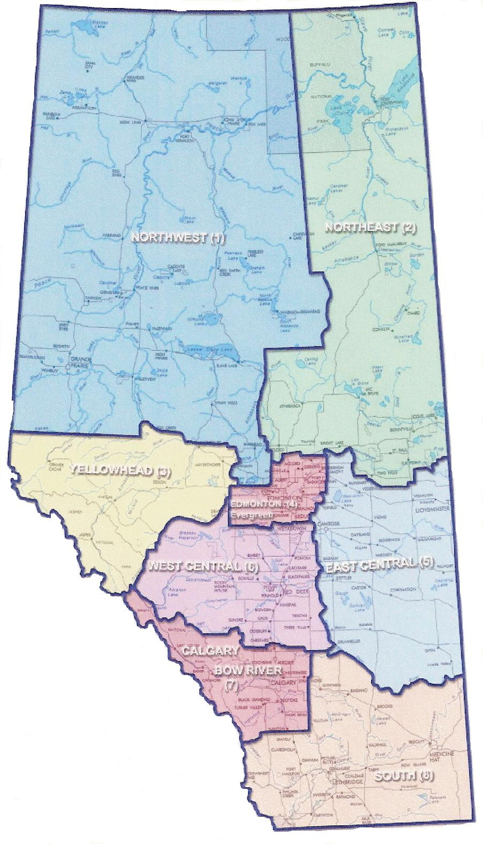
FCSS Programs In Alberta
315 municipalities and Métis settlements, organized into 206 local FCSS programs
(April 1, 2019)
less than 3,800 Albertans reside in communities without FCSS
8 FCSS regions in the province

Slide 15
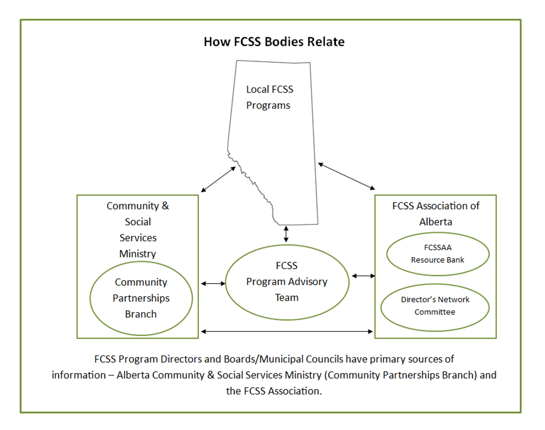

Slide 16
Alberta Community & Social Services – FCSS Team
“the Province” or government side of FCSS
programming and financial administration
where FCSS agreements are signed and funding originates
where Annual Year End Reports and financial statements are submitted
where Outcomes Reports are submitted
Provincial FCSS Director - Karen Wronko
Senior Manager - Joyce Mellott
FCSS Program & Financial Review Officer - Connor Gaughan

Slide 17
FCSS Association of Alberta
representatives from FCSS regions and the Directors’ Network Committee make up the board
strong voice on behalf of FCSS programs, advocating to government and non-government organizations on issues that impact FCSS
works closely with the ministry; solid relationship with other ministries and non-government organizations related to FCSS
annual conference in November
regional meetings occur in the spring

Slide 18
Key FCSSAA Initiatives
Advocacy on issues that impact FCSS and Alberta residents related to things such as:
service delivery
funding
community issues & priorities
Poverty Reduction
Early Childhood Development

